Slide 1
Chapter 8
Arrays and More

Slide 2
Topics
8.1 Arrays
8.2 Array Processing Techniques
8.3 Procedures and Functions That Work with Arrays
8.4 Multidimensional Arrays
8.5 Focus on GUI Design: The Enabled Property and the Timer Control
8.6 Focus on GUI Design: Anchoring and Docking Controls
8.7 Focus on Problem Solving: Building the Demetris Leadership Center Application
8.8 Using Lists to Hold Information (Optional Topic)

Slide 3
Introduction
Arrays are like groups of variables that allow you to store sets of similar data
A single dimension array is useful for storing and working with a single set of data
A multidimensional array can be used to store and work with multiple sets of data
Array programming techniques covered
Summing and averaging all the elements in an array
Summing all the columns in a two-dimensional array
Searching an array for a specific value
Using parallel arrays

Slide 4
Arrays
8.1

Slide 5
Array Characteristics
An array stores multiple values of same type
Like a group of variables with a single name
For example, the days of the week might be:
A set of 7 string variables
With a maximum length of 9 characters
All variables within an array are called elements and must be of the same data type
You access the elements in an array through a subscript

Slide 6
Subscript Characteristics
A subscript, also called an index, is a number that identifies a specific element within an array
Subscript numbering works like a list box index:
Subscript numbering begins at 0
1st element in an array is always subscript 0
Last element is total number of elements – 1
An array with 7 elements refers to the 1st element as subscript 0 and the last element as subscript 6

Slide 7
Declaring an Array
Declare an array much like a regular variable
ArrayName is the name of the array
UpperSubscript is the value of the array's highest subscript
Must be a positive Integer
Positive Integer named constant
Integer variable containing a positive number
DataType is a Visual Basic data type
Dim ArrayName (UpperSubscript) As DataType

Slide 8
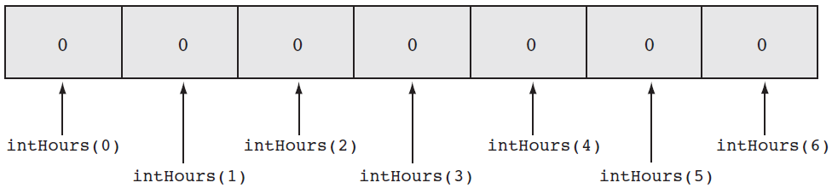
Array Declaration Example
This statement declares intHours as an array of Integers
(6) indicates that the array’s highest subscript is 6
Consists of seven elements with subscripts 0 through 6
Array elements are initialized to 0
Dim intHours(6) As Integer

Slide 9
Default Initialization
All elements of an Integer array are initialized to zero
Same initialization as an integer variable
Each array element is initialized exactly the same as a simple variable of that data type
Decimal elements are initialized to zero (0.0)
String elements are initialized to the special value Nothing

Slide 10
Implicit Array Sizing and Initialization
An array can be initialized when declared
Example:
This array is implicitly sized
Upper subscript value is left blank
Number of elements implied from initialization
Upper subscript of 5 implied by this example
This results in a 6 element array
Elements are assigned the values shown
Dim intNumbers() As Integer = { 2, 4, 6, 8, 10, 12 }

Slide 11
Using Named Constants as Subscripts in Array Declarations
A named constant may be used as an array's highest subscript instead of a number
This is a common use for named constants
Highest subscript is often used multiple times
If highest subscript changes, use of a named constant allows it to be changed in one place
Const intMAX_SUBSCRIPT As Integer = 100
Dim intArray(intMAX_SUBSCRIPT) As Integer

Slide 12
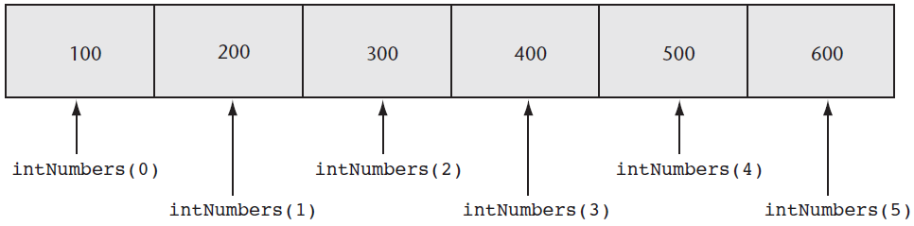
Working with Array Elements
You can store a value in an array element with an assignment statement
intNumbers(0) = 100
intNumbers(1) = 200
intNumbers(2) = 300
intNumbers(3) = 400
intNumbers(4) = 500
intNumbers(5) = 600

Slide 13
Accessing Array Elements with a Loop
Loops are frequently used to process arrays
Using an Integer variable as a subscript
For example, the following code stores an empty string in each element of strNames, a 1000-element array of strings:
Const intMAX_SUBSCRIPT As Integer = 999
Dim strNames(intMAX_SUBSCRIPT) As String
Dim intCount As Integer
For intCount = 0 To intMAX_SUBSCRIPT
strNames(intCount) = String.Empty
Next

Slide 14
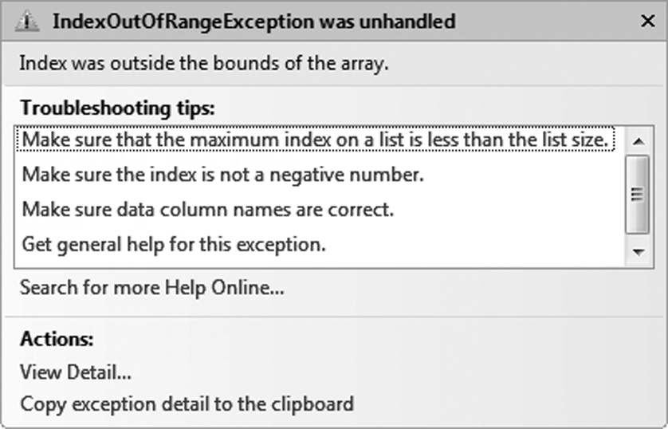
Array Bounds Checking
The Visual Basic runtime system performs array bounds checking
It does not allow a statement to use a subscript outside the range of valid subscripts for an array
An invalid subscript causes VB to throw a run-time exception
Bounds checking is not done at design time

Slide 15
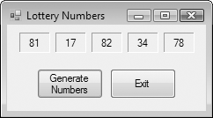
Using an Array to Hold a List of Random Numbers
In Tutorial 8-1 you will create an application that randomly generates lottery numbers
Const intMAX_SUBSCRIPT As Integer = 4
Dim intNumbers(intMAX_SUBSCRIPT) As Integer
Dim intCount As Integer
Dim rand As New Random
For intCount = 0 To intMAX_SUBSCRIPT
intNumbers(intCount) = rand.Next(100)
Next

Slide 16
Using Array Elements to Store Input
Array elements can hold data entered by the user
In Tutorial 8-2 you will create an application that
Uses input boxes to read a sequence of strings as input
Stores those strings in an array
Const intMAX_SUBSCRIPT As Integer = 9
Dim intSeries(intMAX_SUBSCRIPT) As Integer
Dim intCount As Integer
For intCount = 0 To intMAX_SUBSCRIPT
intSeries(intCount) = CInt(InputBox("Enter a number."))
Next

Slide 17
Getting the Length of an Array
Arrays have a Length property
Holds the number of elements in the array
For example
strNames.Length – 1 as the loop’s upper limit
Length property is 1 greater than the upper subscript
Dim strNames() As String = { "Joe", "Geri", "Rose" }
For intCount = 0 to strNames.Length – 1
MessageBox.Show(strNames(intCount))
Next

Slide 18
Processing Array Contents
Array elements can be used just like regular variables in operations
For example
Multiplication
Addition
Format String
In Tutorial 8-3 you will complete an application that performs calculations using array elements
decGrossPay = intHours(3) * decPayRate
intTallies(0) += 1
MessageBox.Show(decPay(5).ToString("c"))

Slide 19
Accessing Array Elements with a For Each Loop
The For Each loop can simplify array processing
Retrieves the value of each element
Cannot modify values
Here is the general format:
var is the name of a variable just for use with the loop
type is the data type of the array
array is the name of an array
For example, suppose we have the following array declaration:
The following For Each loop displays all the values in a list box named lstShow:
Dim intArray() As Integer =
{10, 20, 30, 40, 50, 60}
For Each var As type In array
statements
Next
For Each intVal As Integer
In intArray
lstShow.Items.Add(intVal)
Next

Slide 20
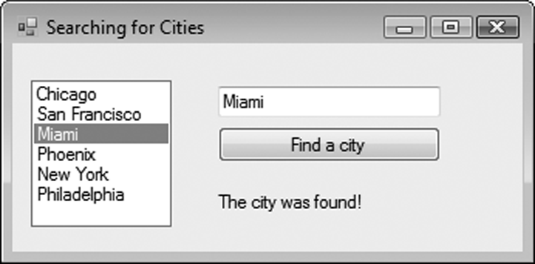
Optional Topic: Using the For Each Loop with a ListBox
A For Each loop can also be used to process items in a collection
For example, to search for a city name in the Items collection of a ListBox control named lstCities
For Each strCity As String In lstCities.Items
If strCity = txtCity.Text Then
lblResult.Text = "The city was found!"
End If
Next

Slide 21
Array Processing Techniques
8.2

Slide 22
How to Total the Values in a Numeric Array
To total the values in a numeric array
Use a loop with an accumulator variable
A For…Next loop for example:
Const intMAX_SUBSCRIPT As Integer = 24
Dim intUnits(intMAX_SUBSCRIPT) As Integer
Dim intTotal As Integer = 0
Dim intCount As Integer
For intCount = 0 To (intUnits.Length – 1)
intTotal += intUnits(intCount)
Next

Slide 23
How to Total the Values in a Numeric Array
You can also use a For Each loop with an accumulator variable
After the loop finishes
intTotal will contain the total of all the elements in intUnits
Dim intTotal As Integer = 0
For Each intVal As Integer In intUnits
intTotal += intVal
Next

Slide 24
Calculating the Average Value in a Numeric Array
Sum the values in the array
Divide the sum by the number of elements
Const intMAX_SUBSCRIPT As Integer = 24
Dim intUnits(intMAX_SUBSCRIPT) As Integer
Dim intTotal As Integer = 0
Dim dblAverage As Double
Dim intCount As Integer
For intCount = 0 To (intUnits.Length – 1)
intTotal += intUnits(intCount)
Next
' Use floating-point division to compute the average.
dblAverage = intTotal / intUnits.Length

Slide 25
Find the Highest and Lowest Values in an Integer Array
Highest Value
Dim intUnits() As Integer = {1, 2, 3, 4, 5}
Dim intCount As Integer
Dim intHighest As Integer
' Get the first element.
intHighest = intUnits(0)
' Search for the highest value.
For intCount = 1 To (intUnits.Length - 1)
If intUnits(intCount) > intHighest Then
intHighest = intNumbers(intCount)
End If
Next

Slide 26
Find the Highest and Lowest Values in an Integer Array
Lowest Value
Dim intUnits() As Integer = {1, 2, 3, 4, 5}
Dim intCount As Integer
Dim intLowest As Integer
' Get the first element.
intLowest = intUnits(0)
' Search for the lowest value.
For intCount = 1 To (intUnits.Length - 1)
If intUnits(intCount) < intLowest Then
intLowest = intNumbers(intCount)
End If
Next

Slide 27
Copying One Array’s Contents to Another
A single assignment statement
Does not copy array values into another array
Causes both array names to reference the same array in memory
A loop must be used to copy individual elements from one array to another
intNewValues = intOldValues
For intCount = 0 To (intOldValues.Length-1)
intNewValues(intCount) = intOldValues(intCount)
Next

Slide 28
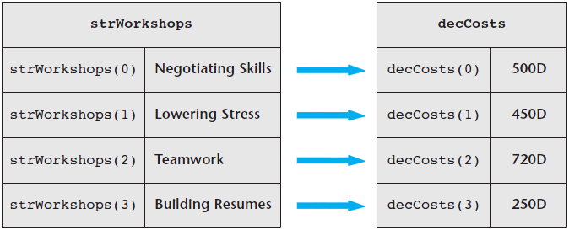
Parallel Arrays
Related data in multiple arrays can be accessed using the same subscript
Tutorial 8-4 examines an application that uses parallel arrays
Const intMAX As Integer = 4
Dim strWorkshops(intMAX) As String = {"Negotiating Skills",
"Lowering Stress", "Teamwork", "Building Resumes"}
Dim decCosts(intMAX) As String = {500D, 450D, 720D, 250D}

Slide 29
Parallel Relationships between Arrays, List Boxes, and Combo Boxes
' A list box with names
lstPeople.Items.Add("Jean James") ' Index 0
lstPeople.Items.Add("Kevin Smith") ' Index 1
lstPeople.Items.Add("Joe Harrison") ' Index 2
' An array with corresponding phone numbers
phoneNumbers(0) = "555-2987" ' Element 0
phoneNumbers(1) = "555-5656" ' Element 1
phoneNumbers(2) = "555-8897" ' Element 2
' Display the phone number for the selected person’s name.
If lstPeople.SelectedIndex > -1 And
lstPeople.SelectedIndex < phoneNumbers.Length Then
MessageBox.Show(phoneNumbers(lstPeople.SelectedIndex))
Else
MessageBox.Show("That is not a valid selection.")
End If

Slide 30
Arrays That Point to Other Data
Arrays can be useful when you need to look up information in another array that has its data in a different order
To match up the data in strWorkshops to strCities, we create a location array that tells us where each workshop is located:
Const intMAX As Integer = 4
Dim strWorkshops(intMAX) As String = {"Negotiating Skills",
"Lowering Stress", "Teamwork", "Building Resumes"}
Dim decCosts(intMAX) As String = {500D, 450D, 720D, 250D}
Dim strCities() As String = {"Chicago", "Miami", "Atlanta",
"Denver", "Topeka", "Indianapolis"}
Dim intLocations() As Integer = {3, 0, 1, 4}

Slide 31
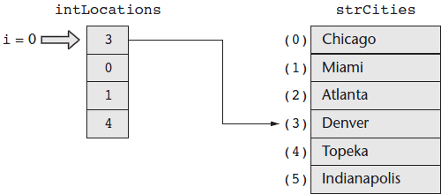
Arrays That Point to Other Data
For i As Integer = 0 to strWorkshops.Length-1
lstShow.Items.Add( strWorkshops(i) & " will cost " & decCosts(i)&
" and will be held in " & strCities(intLocations(i)))
Next i
In the loop, when i = 0:
intLocations(0) contains the value 3
3 is used as the subscript for strCities
The element in the strCities(3) is "Denver"

Slide 32
Searching Arrays
The most basic method of searching an array is the sequential search
Uses a loop to examine elements in the array
Compares each element with the search value
Stops when the value is found or the end of the array is reached
The Pseudocode for a sequential search is as follows:
found = False
subscript = 0
Do While found is False and
subscript < array's length
If array(subscript) = searchValue Then
found = True
position = subscript
End If
subscript += 1
End While

Slide 33
Sorting an Array
Programmers often want to sort, or arrange the elements of an array in ascending order
Values are arranged from lowest to highest
Lowest value is stored in the first element
Highest value is stored in the last element
To sort an array in ascending order
Use the Array.Sort method
Here is the general format:
ArrayName is the name of the array you want to sort
For example:
After the statement executes, the array values are in the following order
1, 3, 6, 7, 12
Array.Sort(ArrayName)
Dim intNumbers() As Integer =
{7, 12, 1, 6, 3}
Array.Sort(intNumbers)

Slide 34
Sorting an Array
When you pass an array of strings to the Array.Sort method the array is sorted in ascending order
According to the Unicode encoding scheme
Sort occurs in alphabetic order
Numeric digits first
Uppercase letters second
Lowercase letters last
For example:
After the statement executes, the values in the array appear in this order:
"Adam", "Bill", "Kim", "dan"
Dim strNames() As String =
{"dan", "Kim", "Adam", "Bill"}
Array.Sort(strNames)

Slide 35
Dynamically Sizing Arrays
You can change the number of elements in an array at runtime, using the ReDim statement
Preserve is optional
If used, the existing values of the array are preserved
If not, the existing values are destroyed
Arrayname is the name of the array being resized
UpperSubscript is the new upper subscript
Must be a positive whole number
If smaller that it was, elements at the end are lost
ReDim [Preserve] Arrayname (UpperSubscript)

Slide 36
Dynamically Sizing Arrays Example
You can initially declare an array with no size, as follows:
Then prompt the user for the number of elements
And resize the array based on user input
Dim dblScores() As Double
intNumScores = CInt(InputBox("Enter the number of test scores."))
If intNumScores > 0 Then
ReDim dblScores (intNumScores - 1)
Else
MessageBox.Show("You must enter 1 or greater.")
End If

Slide 37
Procedures and Functions That Work with Arrays
8.3

Slide 38
Passing Arrays as Arguments
Procedures can be written to process the data in arrays
Store data in an array
Display an array’s contents
Sum or average the values in an array
Usually such procedures accept an array as an argument
Pass the name of the array as the argument to the procedure or function
' The DisplaySum procedure displays the
' sum of the elements in the argument array.
Sub DisplaySum(ByVal intArray() As Integer)
Dim intTotal As Integer = 0 ' Accumulator
Dim intCount As Integer ' Loop counter
For intCount = 0 To (intArray.Length - 1)
intTotal += intArray(intCount)
Next
MessageBox.Show("The total is " &
intTotal.ToString())
End Sub
Dim intNumbers() As Integer =
{ 2, 4, 7, 9, 8, 12, 10 }
DisplaySum(intNumbers)

Slide 39
Passing Arrays by Value and by Reference
Array arguments can be accessed and modified if passed ByVal or ByRef
ByVal prevents an array from being assigned to another array
ByRef allows an array to be assigned to another array
After the ResetValues procedure executes
If passed ByVal
intNumbers is unchanged and keeps the values {1, 2, 3, 4, 5}
If passed ByRef
intNumbers will reference the newArray values {0, 0, 0, 0, 0}
Dim intNumbers() As Integer = { 1, 2, 3, 4, 5 }
ResetValues(intNumbers)
Sub ResetValues(ByVal intArray() As Integer)
Dim newArray() As Integer = {0, 0, 0, 0, 0}
intArray = newArray
End Sub

Slide 40
Returning an Array from a Function
' Get three names from the user and return
' them as an array of strings.
Function GetNames() As String()
Const intMAX_SUBSCRIPT As Integer = 2
Dim strNames(intMAX_SUBSCRIPT) As String
Dim intCount As Integer
For intCount = 0 To 3
strNames(intCount) = InputBox("Enter name " &
(intCount.ToString())
Next
Return strNames
End Function
Tutorial 8-5 demonstrates passing an array to procedures and functions
Dim strCustomers() As String
strCustomers = GetNames()

Slide 41
Multidimensional Arrays
8.4

Slide 42
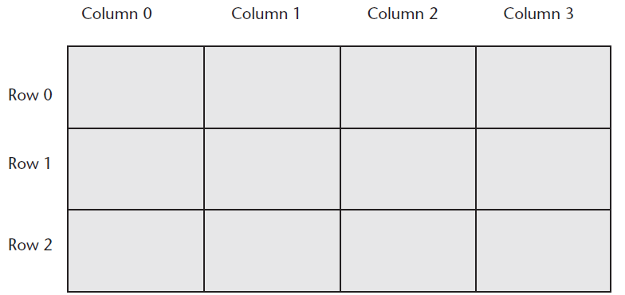
Two-Dimensional Arrays
An array with one subscript is called a one-dimensional array
Useful for storing and working with a single set of data
A two-dimensional array is like an array of arrays
Used to hold multiple sets of values
Think of it as having rows and columns of elements

Slide 43
Declaring a Two-Dimensional Array
A two-dimensional array declaration requires two sets of upper subscripts
First upper subscript is for the rows
Second upper subscript for the columns
ArrayName is the name of the array
UpperRow is the value of the highest row subscript
Must be a positive integer
UpperColumn is the value of the highest column subscript
Must be a positive integer
DataType is the Visual Basic data type
Example declaration with three rows and four columns:
Dim ArrayName (UpperRow,UpperColumn) As DataType
Dim dblScores (2, 3) As Double

Slide 44
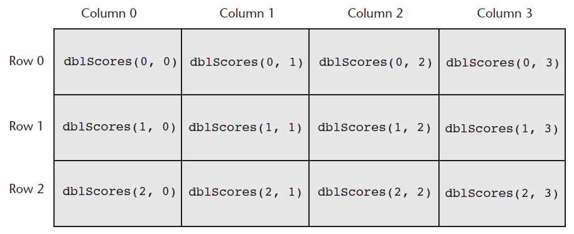
Processing Data in Two-Dimensional Arrays
Use named constants to specify the upper subscripts
Const intMAX_ROW As Integer = 2
Const intMAX_COL As Integer = 3
Dim dblScores(intMAX_ROW, intMAX_COL) As Double

Slide 45
Processing Data in Two-Dimensional Arrays
The elements in row 0 are referenced as follows:
The elements in row 1 are referenced as follows:
The elements in row 2 are referenced as follows:
dblScores(0, 0) ' Element in row 0, column 0
dblScores(0, 1) ' Element in row 0, column 1
dblScores(0, 2) ' Element in row 0, column 2
dblScores(0, 3) ' Element in row 0, column 3
dblScores(1, 0) ' Element in row 1, column 0
dblScores(1, 1) ' Element in row 1, column 1
dblScores(1, 2) ' Element in row 1, column 2
dblScores(1, 3) ' Element in row 1, column 3
dblScores(2, 0) ' Element in row 2, column 0
dblScores(2, 1) ' Element in row 2, column 1
dblScores(2, 2) ' Element in row 2, column 2
dblScores(2, 3) ' Element in row 2, column 3

Slide 46
Processing Data in Two-Dimensional Arrays
Example of storing a number in a single element
Example of prompting the user for input, once for each element
Example of displaying all of the elements in the array
dblScores(2, 1) = 95
For intRow = 0 To intMAX_ROW
For intCol = 0 To intMAX_COL
dblScores(intRow, intCol) =
CDbl(InputBox("Enter a score."))
Next
Next
For intRow = 0 To intMAX_ROW
For intCol = 0 To intMAX_COL
lstOutput.Items.Add(dblScores(intRow, intCol).ToString())
Next
Next

Slide 47
Implicit Sizing and Initialization of Two-Dimensional Arrays
When providing an initialization list for a two-dimensional array, keep in mind that:
You cannot provide the upper subscript numbers
You must provide a comma to indicate the number of dimensions
Values for each row are enclosed in their own set of braces
This statement declares an array
with three rows and three columns:
Dim intNumbers(,) As Integer =
{ {1, 2, 3} ,
{4, 5, 6} ,
{7, 8, 9} }
intNumbers(0, 0) is set to 1
intNumbers(0, 1) is set to 2
intNumbers(0, 2) is set to 3
intNumbers(1, 0) is set to 4
intNumbers(1, 1) is set to 5
intNumbers(1, 2) is set to 6
intNumbers(2, 0) is set to 7
intNumbers(2, 1) is set to 8
intNumbers(2, 2) is set to 9

Slide 48
Summing the Columns of a Two-Dimensional Array
The outer loop controls the intCol subscript
The inner loop controls the intRow subscript
Tutorial 8-6 uses a two-dimensional array in the Seating Chart application
' Sum the columns.
For intCol = 0 To intMAX_COL
' Initialize the accumulator.
intTotal = 0
' Sum all rows within this column.
For intRow = 0 To intMAX_ROW
intTotal += intValues(intRow, intCol)
Next
' Display the sum of the column.
MessageBox.Show("Sum of column " &
intCol.ToString() & " is " & intTotal.ToString())
Next

Slide 49
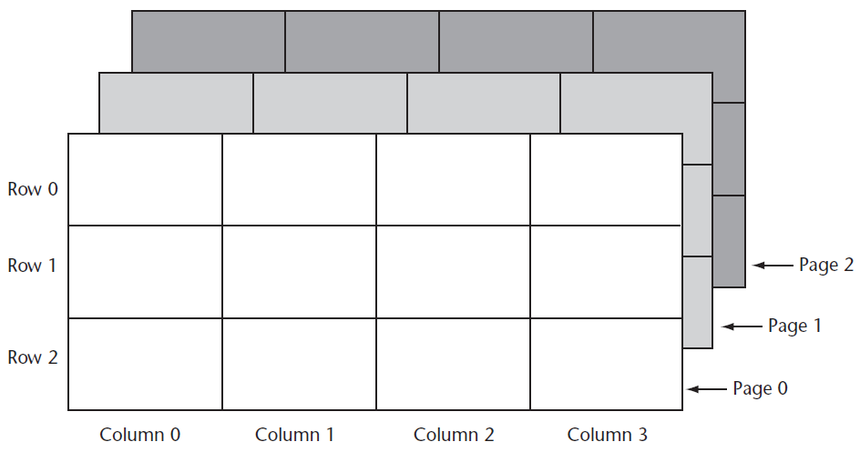
Three-Dimensional Arrays and Beyond
You can create arrays with up to 32 dimensions
The following is an example of a three-dimensional array:
Dim intPages(2, 2, 3) As Decimal

Slide 50
Three-Dimensional Arrays and Beyond
Arrays with more than three dimension are difficult to visualize
Useful in some programming applications
For example:
A factory warehouse where cases of widgets are stacked on pallets, an array of four dimensions can store a part number for each widget
The four subscripts of each element can store:
Pallet number
Case number
Row number
Column number
A five dimensional array could be used for multiple warehouses

Slide 51
Focus on GUI Design: The Enabled Property and the Timer Control
8.5

Slide 52
The Enabled Property
Most controls have an Enabled property
If this Boolean property is set to False the control is disabled meaning the control:
Cannot receive the focus
Cannot respond to user generated events
Will appear dimmed, or grayed out
Default value for this property is True
May be set in code when needed as shown:
radBlue.Enabled = False

Slide 53
The Timer Control
The Timer control allows an application to automatically execute code at regular intervals
To place a Timer control on a form:
Double-click the Timer icon in Components section of the Toolbox
Appears in the component tray at design time
Prefix a Timer control’s name with tmr
To create a Tick event handler code template:
Double-click a Timer control that has been added to the Component tray
Code will be executed at regular intervals

Slide 54
Timer Control Properties
Timer control has two important properties:
The Enabled property
Must be set to True to respond to Tick events
The Interval property
The number of milliseconds that elapse between events
Tutorial 8-7 demonstrates the Timer control
In Tutorial 8-8 you will use the Timer control to create the Catch Me game application

Slide 55
Focus on GUI Design: Anchoring and Docking Controls
8.6

Slide 56
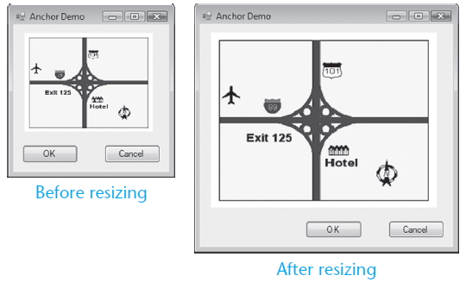
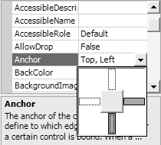
The Anchor Property
The Anchor property allows you to anchor the control to one or more edges of a form
Controls are anchored to the top and left edges of the form by default

Slide 57
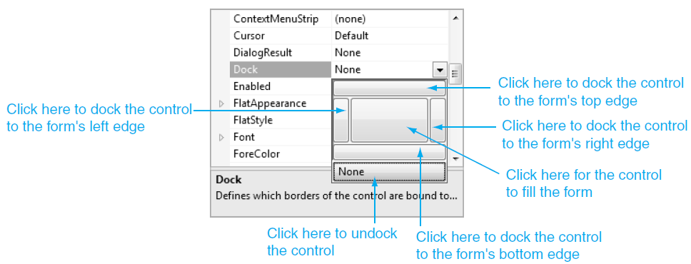
The Dock Property
The Dock property docks a control against a form’s edge
Buttons are automatically sized to fill up in edge which they are docked

Slide 58
Focus on Problem Solving: Building the Demetris Leadership Center Application
8.7

Slide 59
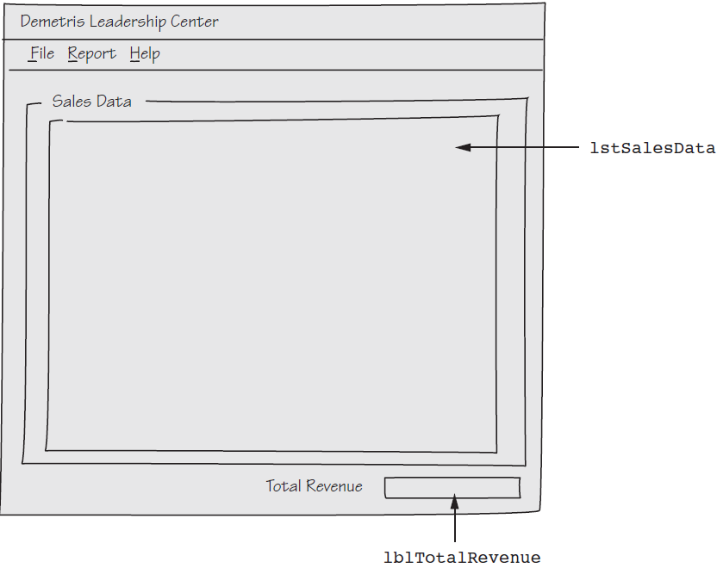
Sketch of the Application’s Form

Slide 60
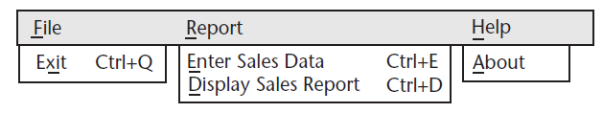
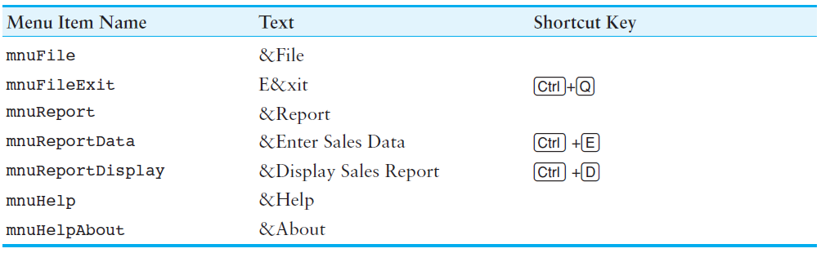
The Menu System

Slide 61
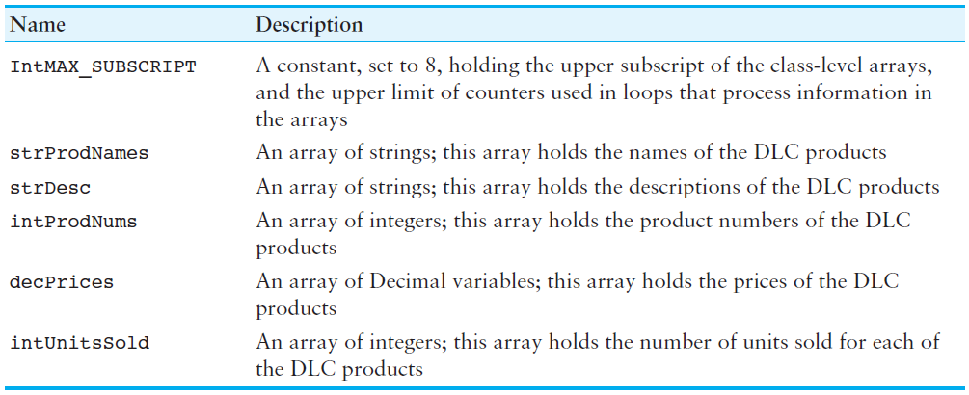
Class-Level Declarations

Slide 62
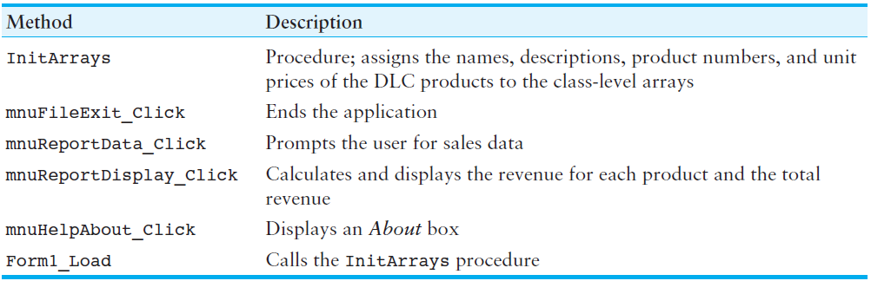
Methods

Slide 63
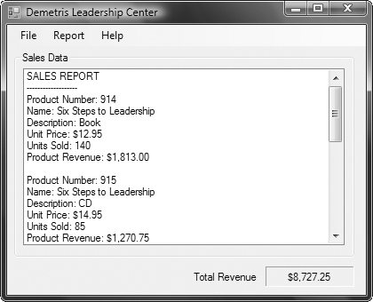
Sales Report Displayed

Slide 64
Using Lists to Hold Information (Optional Topic)
8.8

Slide 65
The List Data Type
In Visual Basic you can use the List data type to hold a set of items
Similar to an array, but has advantages
Can grow dynamically
Item removal is easy
Has a built-in searching function
The Items property of the ListBox control contains a List
The Add, Remove, and Clear methods belong to the List

Slide 66
Declaring List Variables
When declaring a List variable:
Specify the type of data the list will store
Use the new keyword to create the List object
A List can be declared and created with a single statement
A List always contains a single data type
Dim lstNames As List(Of String)
lstNames = New List(Of String)
Dim lstNames As New List(Of String)
Dim lstScores As New List(Of Integer)
Dim lstTemperatures As New List(Of Double)

Slide 67
Choosing Identifier Names
When naming list variables, you may optionally begin the variable name with a prefix
Using the lst prefix, for example
lst is also used for ListBox controls
Try using the data type prefix along with a plural noun
Dim lstStrNames As List(Of String)
Dim lstIntScores As List(Of Integer)
Dim strNames As List(Of String)
Dim intScores As List(Of Integer)

Slide 68
Common List Operations
The Add method adds an item to a list
The Remove method removes an item from the list
The Clear method removes all items from the list
The Count method returns the size of a list
Use an index to access any existing item in the list
Replace an item in the list by using a subscript
Tutorial 8-10 demonstrates building a list of names
lstNames.Add("Fred")
lstNames.Remove("Sam")
lstNames.Clear()
intCount = lstNames.Count()
lblResult.Text = lstNames(0) 'returns: Fred
lstNames(0) = "Ben"

Slide 69
Accessing a List with a Subscript
Using a For-Each loop to process all the elements in a list is a very easy technique
Sometimes you will want to use a loop counter to do the same thing
For example:
Dim intIndex As Integer = 0
Dim strName As String
For intIndex = 0 To lstNames.Count - 1
strName = lstNames(intIndex)
lstFriends.Items.Add(strName)
Next

Slide 70
Searching for Items in a List
Using the IndexOf method is an easy way to search for an item in a List
The IndexOf method:
Accepts a value as an argument
Returns the index if the value is found
Returns -1 if the value is not found
' Create a List of strings.
Dim lstNames As New List(Of String)
lstNames.Add("Chris")
lstNames.Add("Kathryn")
lstNames.Add("Bill")
' Search for "Kathryn".
Dim intPosition As Integer =
lstNames.IndexOf("Kathryn")
' Was Kathryn found in the List?
If intPosition <> -1 Then
MessageBox.Show
("Kathryn was found " &
"at index " & intPosition)
Else
MessageBox.Show
("Kathryn was not found.")
End If

Slide 71
Searching for Items in a List
There are two additional versions of the IndexOf method
Allow you to specify the area of the List that should be searched
Invalid indices will cause an exception to occur
In this version, you specify a search value and a starting index
In this version, you specify a search value along with the starting and ending indices for the range in which you want search
The IndexOf method performs a sequential search, so you may notice a slight delay when performing searches with very large lists
intPosition = lstNames.IndexOf("Diane", 2)
intPosition = lstNames.IndexOf("Diane", 2, 5)

